Slide 1
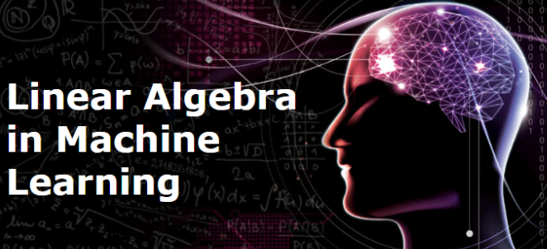
Day 41 – Linear Algebra for Machine Learning (Vectors) Why Linear Algebra is Important in Machine Learning?
Machine Learning models do not work on single values. They work on:
Lists of numbers
Groups of features
High-dimensional data
These lists of numbers are called Vectors.
Without vectors:
No ML models
No Deep Learning
No Neural Networks

Slide 2
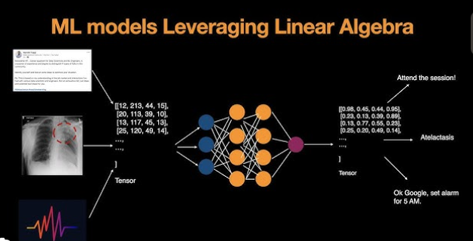
Why We Are Learning This
Till now:
• Python → writing logic • SQL → handling data • Statistics → understanding patterns
Now:
👉 How machines represent information mathematically
Important fact:
Computers do not understand:
• Images • Text • Humans
They understand only:
👉 Numbers arranged in vectors
Machine Learning = Numbers + Mathematics

Slide 3
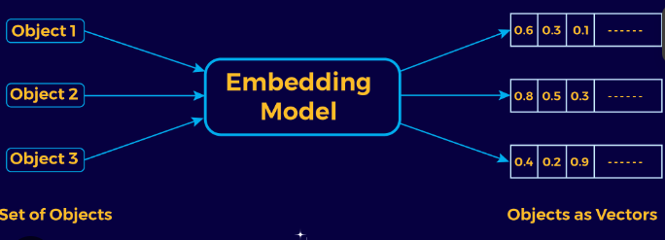
What is a Vector (From Real World to Math)
Real world examples:
• Student marks → (Math, Science, English) • Person body → (Height, Weight, Age) • Car movement → (Speed, Direction)
Mathematical form:
V = (x, y)
Meaning:
Move x units in horizontal direction Move y units in vertical direction
So vector = quantity with multiple values.
“We can say Vector is simply structured information.”

Slide 4
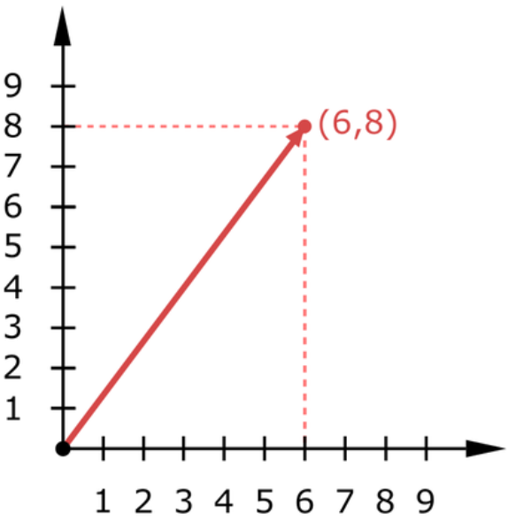
Vector Representation on Graph
Vector starts from origin and points to location.
Example:
V = (6,8)
Means:
6 units right 8 units up
This creates an arrow.

Slide 5
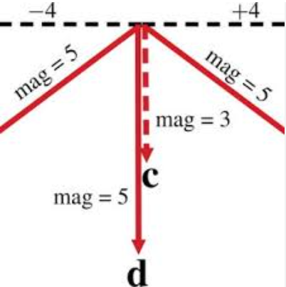
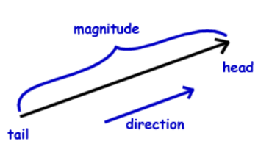
Magnitude of Vector (Where Formula Comes From)?
Question:
How long is vector (6,8) ?
We create a triangle:
Horizontal = 6 Vertical = 8
Using Pythagoras theorem:
|V| = √(x² + y²)
So:
|V| = √(6² + 8²) = 10
Mathematical origin:
Distance formula from geometry.
Real meaning:
Magnitude = strength / size.
Machine Learning:
Used to measure:
• Distance between data points • Error size • Similarity

Slide 6
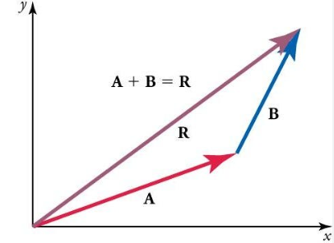
Vector Addition (Mathematical Reason)
Suppose:
A = (3,2)
B = (1,4)
Total movement?
We add directions separately:
Horizontal:
3 + 1 = 4
Vertical:
2 + 4 = 6
So:
A + B = (4,6)
Why mathematically correct?
Because x and y directions are independent dimensions.
Machine Learning meaning:
Combining feature information.
Example:
Income features from two sources.

Slide 7
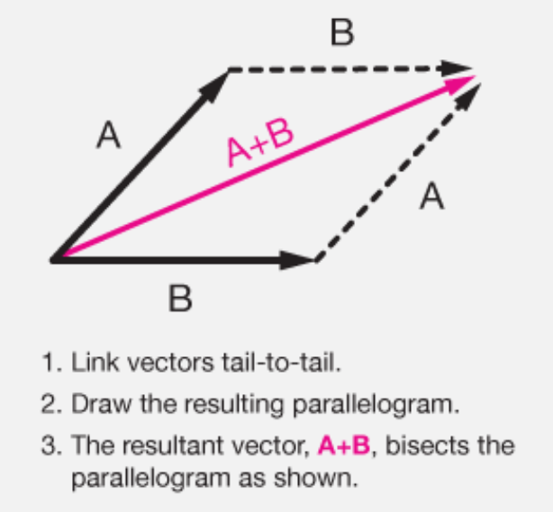
Geometric Interpretation of Addition
Vector addition visually:
Place second vector at end of first vector.
Resultant vector = diagonal.
This comes from parallelogram rule in geometry.
Real meaning:
Combining forces, movements, information.
Machine Learning:
Multiple feature contributions combine to produce one output.

Slide 8
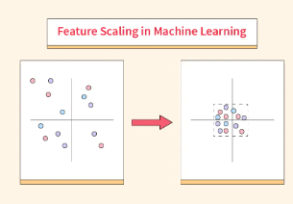
Why Vector Scaling is Important in ML
Real meaning:
• Salary increase • Speed increase • Investment growth
Machine Learning:
Weights scaling during training.
In ML:
Features have different units
One feature may dominate others
Scaling ensures:
Fair contribution of all features
Faster learning
Better model performance
EXAMPLE
Vector:
V = (2,3)
Multiply by 4:
4V = (8,12)
Why?
Because we scale both directions equally:
k(x,y) = (kx, ky)

Slide 9
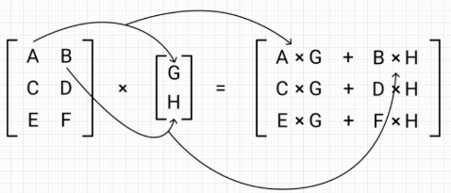
Dot Product of Two Vectors¶
Dot product tells:
How similar two vectors are
How aligned features are
Used in:
Linear Regression
Logistic Regression
Neural Networks
Formula:
v · u = v₁u₁ + v₂u₂ + ...
Example of Dot Product
v= [1, 2]
u = [3, 4]
v · u = (1×3) + (2×4) = 11
Interpretation:
Large value → similar direction Small value → less similarity Zero → perpendicular → no relation

Slide 10
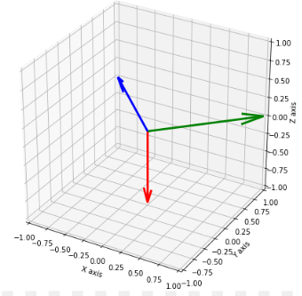
Orthogonality (Very Important Concept)
Two vectors are orthogonal if:
Their dot product is zero
They are perpendicular
Meaning in ML:
No correlation
Independent features
Meaning:
No relationship between vectors.
Real example:
Height vs favorite color.
Machine Learning:
Independent features are important for good models.
EXAMPLE:
v = [1, 0]
u = [0, 1]
v · u = 0
Hence: Vectors are orthogonal

Slide 11
CROSS PRODUCT IN ML (OPTIONAL)
Cross product:
Produces a vector perpendicular to both input vectors
Defined only in 3D space
Used in:
Physics
Robotics
3D graphics
Why Cross Product is Less Important in ML¶
Most ML problems:
Are high dimensional
Do not rely on 3D geometry
So cross product is:
Good to know
Rarely used directly

Slide 12

Vector Norms (Magnitude)¶ Norm = Length of any vector: Types of Norms : 1. L1 norm 2. L2 Norm
L1 Norm (Manhattan Distance)¶
Definition: Sum of absolute values
Example:
v = [3, -4]
L1 = |3| + |−4| = 7
L2 Norm (Euclidean Distance)
Definition: Square root of sum of squares
Example:
v = [3, 4]
L2 = √(3² + 4²) = 5

Slide 13
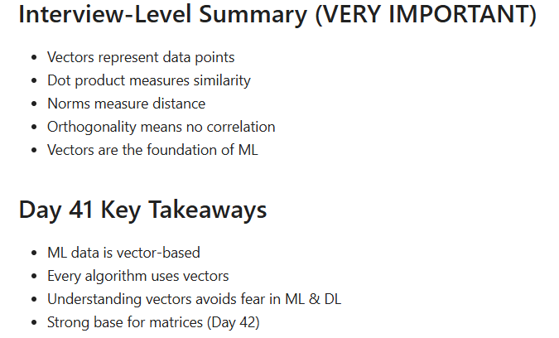
WHY NORMS MATTERS
Norms are used for:
Distance calculation
Similarity measurement
Regularization
Model optimization

